Slide 1

Boston Air BnB
This Photo by Unknown Author is licensed under CC BY-NC-ND

Slide 2

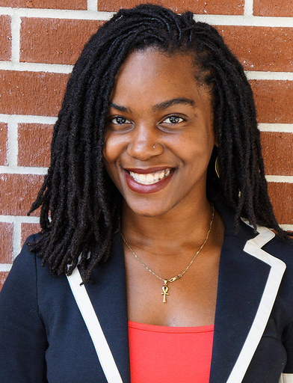

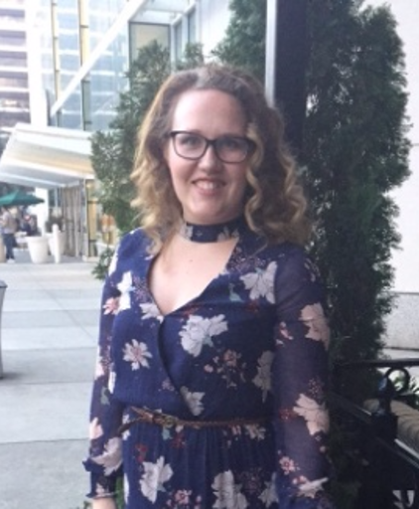
Meet The Team Brynna Bridges De-Anna Clarke Chantay Drake Jewell Foster Alexis Palmer
This Photo by Unknown Author is licensed under CC BY
This Photo by Unknown Author is licensed under CC BY

Slide 3
Motivation & Summary come back chantay

Slide 4
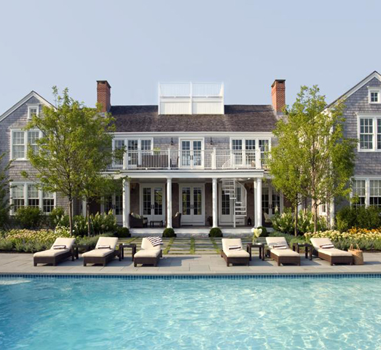
Hypothesis & Null Hypothesis
Research Question: Is there a significant difference between neighborhoods to purchase property in Boston.
Hypothesis: Buying an Airbnb two-bedroom apartment located in Jamaica Plain is significantly better than other neighborhoods based on price and ratings.
Null Hypothesis: There is no significant difference in neighborhoods in relevance to purchasing property.
This Photo by Unknown Author is licensed under CC BY

Slide 5
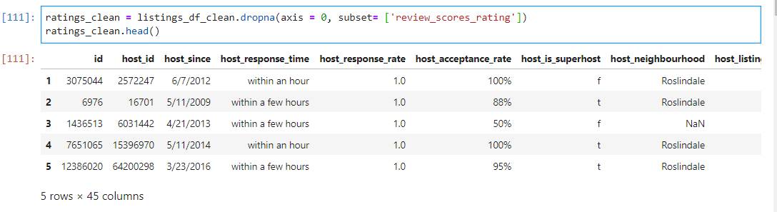
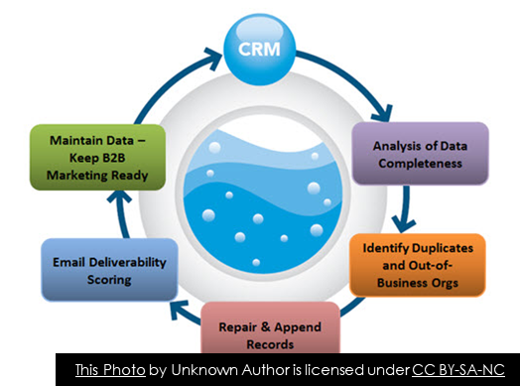
Data Used, Cleanup & Exploration

Slide 6

Data analysis
Questions asked in the proposal:
What is the best location to purchase Airbnb based on:
Property type
Price
Neighborhood
Ratings
This Photo by Unknown Author is licensed under CC BY-SA-NC

Slide 7


P- Values
RATINGS
PRICE

Slide 8
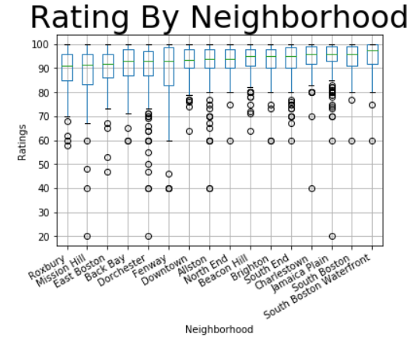
Ratings By Neighborhood

Slide 9
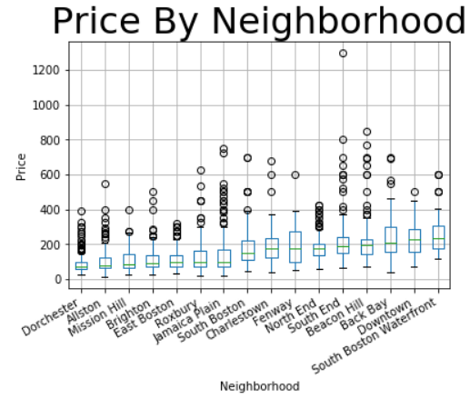
Price By Neighborhood

Slide 10
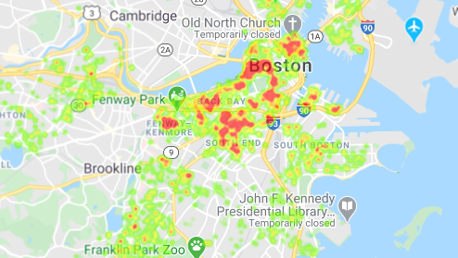
Pricing Heat Map

Slide 11
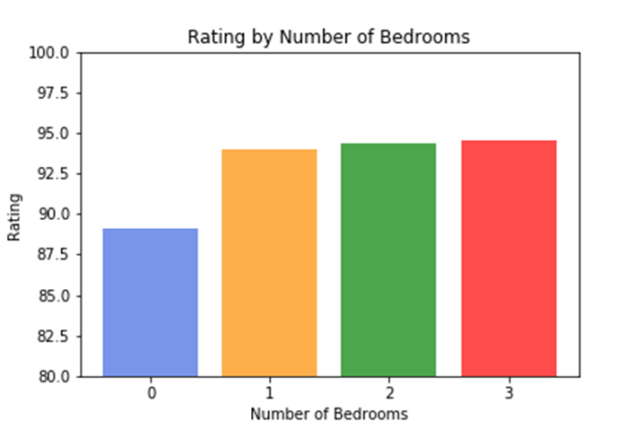
Rating By Bedrooms

Slide 12
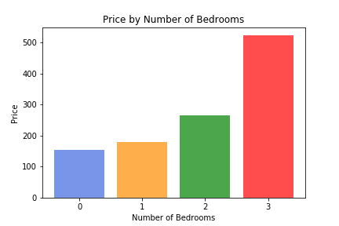
Price By Available Bedrooms

Slide 13
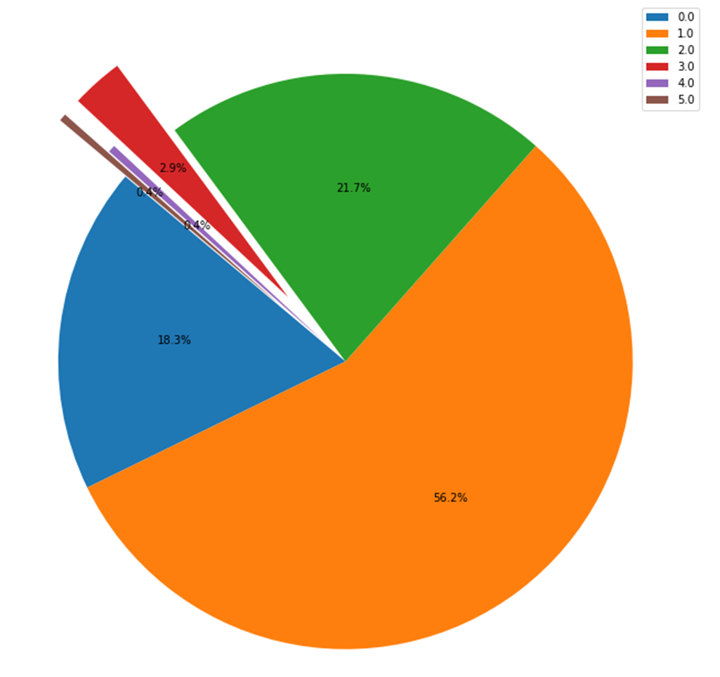
Number of Bedrooms in South End
Number of Bedrooms in
South End

Slide 14
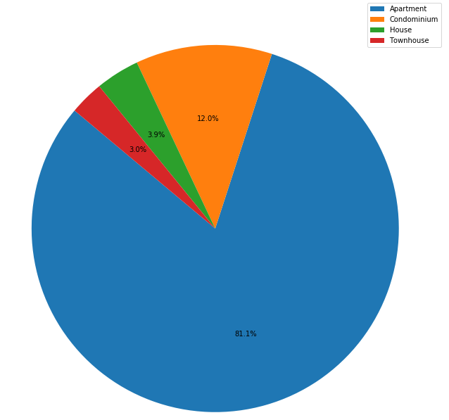
South End Property Type
South End Property Type

Slide 15
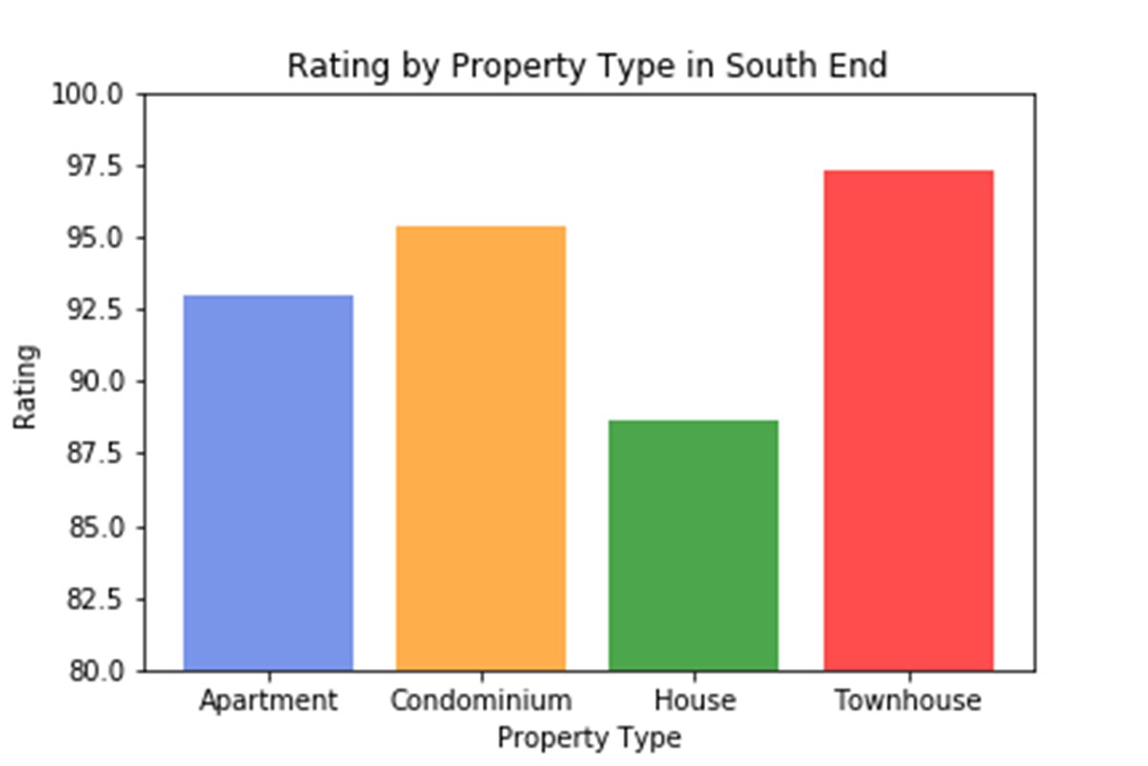
South End’s Rating By Property Type

Slide 16
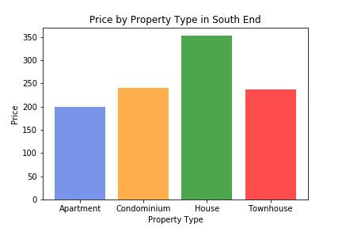
Price By Property Type In South End

Slide 17
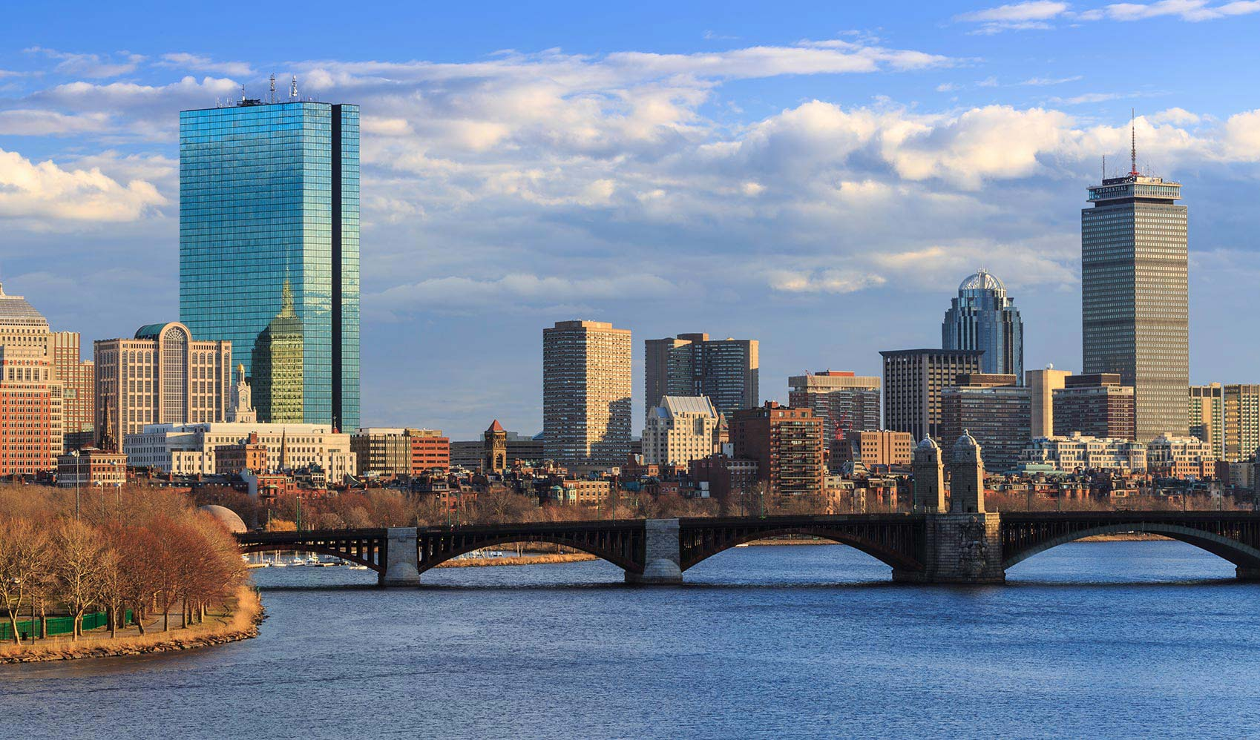
Conclusion
This Photo by Unknown Author is licensed under CC BY-SA-NC

Slide 18
Post Mortem Discuss any difficulties that arose, and how you dealt with them Discuss any additional questions that came up, but which you didn't have time to answer: What would you research next, if you had two more weeks?

